Slide 1
Our Centennial
Brian S. Noble
Centennial Congress Advisor

Slide 2
What is DeMolay’s Centennial Year?
DeMolay International is now celebrating 100 years of brotherhood, comradeship, and building young men's characters to best fit them to be leaders in tomorrows society.
It is time to celebrate!

Slide 3
What can you earn THIS YEAR?
Centennial MSA’s
Pro Awards
Session activities
World Wide Initiation
Let’s get to work!

Slide 4
Centennial MSA’s
MS-MSA
PIKC-MSA
PMC-MSA

Slide 5
Centennial
PMS-MSA

Slide 6
Master Squire MSA
Note: As soon as all requirements are completed the Master Squire must complete and submit to the person designated to administer this program the online Statement of Completion form summarizing his term and explaining the items listed above. The statement must be confirmed by a Manor advisor.
The Centennial Master Squire’s Meritorious Service Award is created to recognize those who serve as Master Squire during some portion of the Order of DeMolay’s 100th Anniversary Year (23rd June 2018 to 29th June 2019) and who meet the following additional requirements. The Master Squire must fulfill these requirements to qualify for this award:
At the beginning of his term he must complete the online Declaration of Intent to Qualify form and notify the person designated to administer this program.
Prior to the completion of his term, the Master Squire must fulfill the following:
Conduct at least three meetings of the Manor
Induct at least three new members
Conduct a Manor social event
Participate in an event with another DeMolay entity (Manor, Chapter, Priory or other)
Participate in a community involvement event f. Participate in a DeMolay Centennial celebration event during the Centennial Year Note: requirements c, d, e and f. must be completed separately; you may not use one event to satisfy more than one requirement

Slide 7
Centennial
PMC-MSA

Slide 8
Master Councilor MSA
It shall not be earned or awarded for service as a jurisdictional officer. The Centennial Past Master Councilor’s Meritorious Service Award is created to recognize those who serve as Master Councilor during some portion of the Order of DeMolay’s 100th Anniversary Year (23rd June 2018 to 29th June 2019) and who meet the following additional requirements.
The Master Councilor must fulfill these requirements to qualify for this award: Prior to his Installation the Master Councilor must:
Memorize his portion in the Ritual of Secret Work.
Present before his installation in printed form (multiple copies for distribution to the entire membership) or electronic format available to the entire membership, a planned program listing all events and dates planned for his term of office. Within ten days after his installation the Master Councilor must:
Complete the online Declaration of Intent to Qualify form and notify the person designated to administer this program.
Include a copy of his term program either as an attachment or by providing a link to its electronic publication site.

Slide 9
Master Councilor MSA
Provide a confirmation statement from a chapter advisor that all requirements to date have been accomplished. Prior to the completion of his term, the Master Councilor must fulfill the following:
He must ensure that degree teams exemplify both degrees of the Order by memory during his term of office, and that all ceremonies from the Ritual of Secret Work are given from memory.
He must see that his chapter initiates at least the number of new members equal to the number of months in his term.
He must hold at least one social, civic, Masonic service, athletic and fund-raising activity in the Chapter.
He must conduct a planned public observance of each Obligatory Day that falls during his term.
He must establish a program which increases and maintains a high-level of attendance at Chapter meetings.
During the Centennial year he must hold an activity or conduct some event which commemorates the 100th Anniversary of DeMolay.

Slide 10
Pro Awards!

Slide 11
Centennial
Pro-Merito

Slide 12
Pro Merito
DeMolay International has designed the Centennial award "Pro Merito". Translating from Latin as “for merit”, Pro Merito is a special merit bar drop that can be earned by any active DeMolay during the Centennial year. Pro Merito is a fantastic way that chapters can reward members who are doing great work and encourage other members to do more. Pro Merito, like all Centennial programs, is designed to drive membership recruitment, retention and activity. Earning this award is a goal any member can easily achieve, and encouraging members to earn it will help any chapter succeed!

Slide 13
Pro Merito
In order to earn this special Centennial award, a DeMolay must do all of the following during the Centennial year:
Be the first-line signer for at least two (2) new members
Attend a minimum of six (6) of his chapter’s meetings
Participate in at least one (1) Fundraising activity; one (1) Social activity; one (1) Civic Service activity; one (1) Masonic Service activity
Attend at least one (1) activity outside his own chapter
Attend a DeMolay Centennial Event Earning this award is a goal any member can easily achieve, and encouraging members to earn it will help any chapter succeed!

Slide 14
Centennial
Pro-Fraternitas

Slide 15
Pro Fraternitas
Any jurisdiction which initiates 100 new members during the Centennial year will receive the award Pro Fraternitas. The insignia of this award will take the form of a battle streamer for a jurisdictional banner or flag, and is to be displayed proudly as an emblem of excellence in the field of membership during the Centennial year. Jursidiction which earns Pro Fraternitas will receive a Pro Fraternitas pop-up banner to display proudly. They will also receive up to a $300 reimbursement to host a social event of their choosing for the 100 new members and their first-line signers. The award winners will be commemorated in our Charity enShrined Centennial Courtyard as well, with a Large Brick inscribed with:
Jurisdiction name
Pro Fraternitas
The Grand Masters Seal
Centennial Emblem 2018-2019

Slide 16
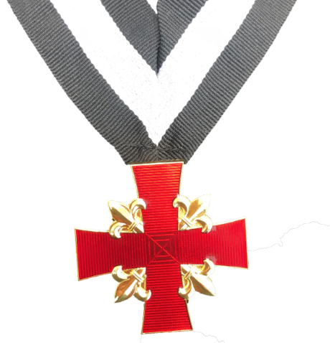
Pro-Servitio
During the Centennial year, Grand Master Patterson will present exactly 100 Pro-Servitio awards.
Translating from Latin as “for Service,” Pro Servitio is given in honor of exemplary service to Grand Master Patterson and the Centennial Year of DeMolay.

Slide 17
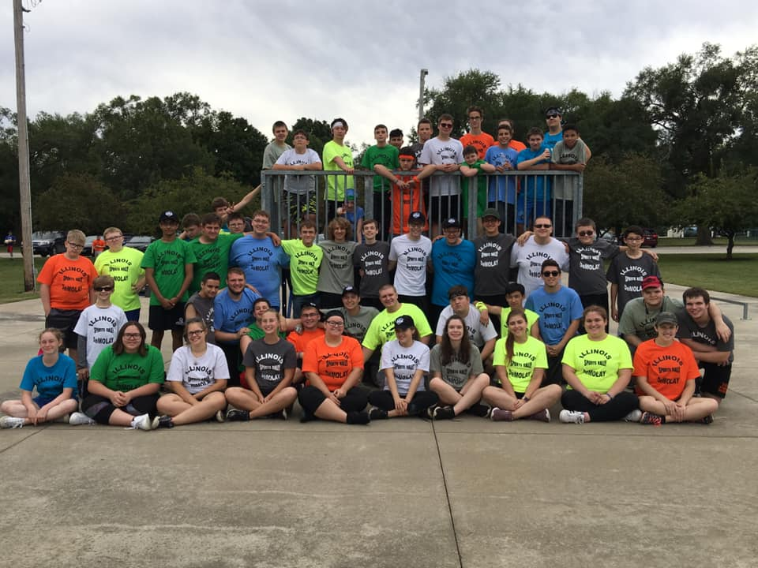
World Wide Initiation!
This is a day for everyone around the world to celebrate! Each Jurisdiction is encouraged to join DeMolay International on Initiating as many people as we can on April 1st at 7:45PM!
We state in DeMolay International
“In celebration of the first recorded meeting of Mother Chapter, DeMolay will hold initiations worldwide in almost every time zone. Since the meeting took place at 7:45pm, chapters are encouraged to start in the evening so that the initiation will take place at roughly the same time.
All DeMolays initiated on Worldwide Initiation Day will be recognized in the Centennial Session Yearbook.”

Slide 18
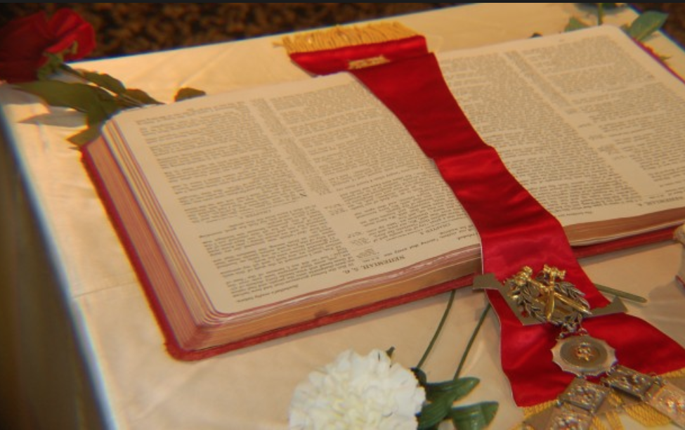
The Centennial Session
This year, and this year only, there will be a Centennial Ritual Competition for Chapters to compete to come out on top!
Competitions will include:
Initiatory Degree
DeMolay Degree
Team Ceremony of Light
Individual Flower Talk

Slide 19
How’s That Sound!?!?
This is an incredible time to be a DeMolay, you are a part of 100 years of our organization, be proud! Get excited to make a difference and celebrate this momentous occasion together!

Slide 20
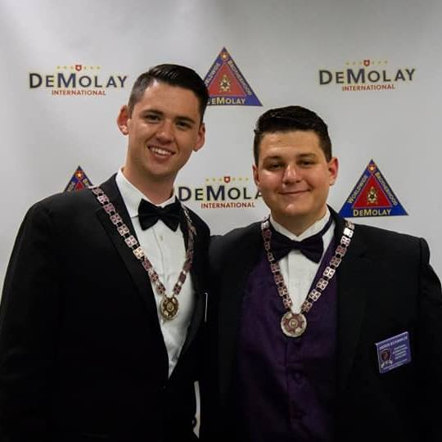
Any Questions? People to ask!

Slide 21
Dad M. Boyd Patterson, Jr. Centennial Grand Master DeMolay International

Slide 22
Resources
www.DeMolay.org/centennial
https://www.youtube.com/watch?v=aEFPOCd8nBo&t=66s

Slide 23
Thank You

